Slide 1
Communicating insights & storytelling with data
Simple techniques for creating a clear, structured narrative to achieve impact

Slide 2
Overview
Section Details
 | BLENDING THE ART OF DESIGN WITH THE SCIENCE OF DATA
 | Definition of data visualization
 | Design principles – Tufte and Gestalts
 | GOOD AND BAD VISUALIZATION
 | THE RIGHT GRAPH FOR THE RIGHT DATA
 | BRINGING IT ALL TOGETHER
 | Visual designing your story
 | Understanding your audience
 | KEY TAKE AWAYS
 | APPENDICES

Slide 3

BLENDING THE ART OF DESIGN WITH THE SCIENCE OF DATA
Data Driven Decision Making
Notes:
The world produces around 2.5 quintillion bytes of data every day, and 90% of all data has been created in the last two years. With so much data, it’s become increasingly difficult to manage and make sense of it all. It would be impossible for any single person to wade through data line-by-line and see distinct patterns and make observations.
Data visualization can provide insight that traditional descriptive statistics cannot.
Our eyes are drawn to colours and patterns. We can quickly identify red from blue, square from circle. Our culture is visual, including everything from art and advertisements to TV and movies.
Data visualization is another form of visual art that grabs our interest and keeps our eyes on the message. When we see a chart, we quickly see trends and outliers. If we can see something, we internalize it quickly. It’s storytelling with a purpose.
If you’ve ever stared at a massive spreadsheet of data and couldn’t see a trend, you know how much more effective a visualization can be.
Our brain reacts to colour, shapes and sizes very quickly and is able to remember them for long.
Data Visualisation, thus, has great implications. But it can also mislead the audience.
It is important to understand the human biases and assumptions, before Visualising the data
A strategy is only as good as its execution. Visualization is a key element of this… interactive visuals to transform data into actionable insights.
The data visualization webcast series shed insights around the impact of effective data visualization and the power of data storytelling.
We hope this learning series inspire you to further innovate and develop your data visualization skills regardless of the preferred choice of tools.
The principles and frameworks shared in the series are applicable to all who need to interact and influence an audience irrespective of
A key purpose of storytelling is not just understanding the world but changing it. After all, why would we study the world if we didn’t want to know how we can—and should—influence it?

Slide 4
The power of telling stories… for your reporting
INFORM
INSPIRE
ENGAGE
“Storytelling is the way knowledgeand understandinghave been
passed down for millennia. The best stories share our valuesand
beliefs. Those stories are powerful. Those stories inspire.”
Simon Sinek
Notes:
Where there is life, there is data, where there is data, there is analytics, visualization can take you anywhere from there
For change to be realized, the science of visualization needs to meet the art of human communication and decision making
Storytelling with data visualization - Facts get recorded, Stories get remembered
Types of Visualization
Insights Video
Story Deck
Dashboard
Info Graphics
Exploratory analyses • Allows audience to explore the data for further analyses • Conducted for a problem that has not been clearly defined
Explanatory analyses • Explains the audience what they need to know • Shows specific relationships in data such as link between causes and results

Slide 5
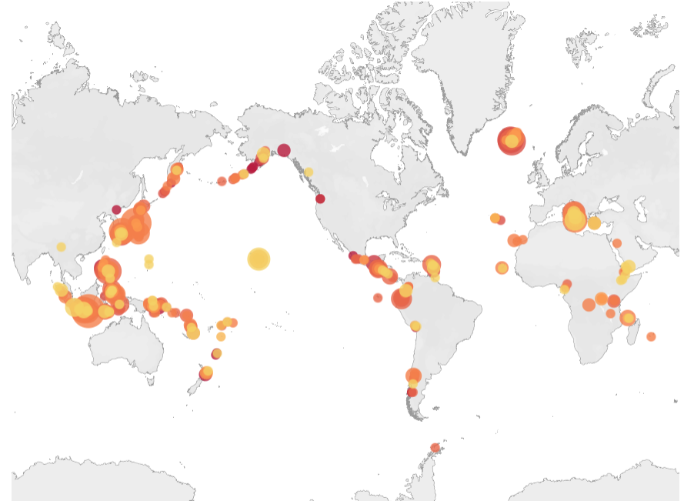
Volcano Elevation and Population Affected Within 100km
VEI
VEI of Different Explosions
Notes:
A significant eruption is classified as one that meets at least one of the following criteria: caused fatalities, caused moderate damage (approximately $1 million or more), Volcanic Explosivity Index (VEI) of 6 or greater, generated a tsunami, or was associated with a significant earthquake
An erupting volcano can trigger tsunamis, flash floods, earthquakes

Slide 6



Design Principles
Proximity
Similarity
Enclosure
Gestalt principles
Edward Tufte’s principles
“Excellence in statistical graphics consists of complex ideas communicated with clarity, precision and efficiency”
Substance of the finding rather than methodology
Avoid Distraction
Present many numbers in a small space efficiently
Compare
Data At Several Levels
Clear Purpose
Understand the Data
Pre-attentive attributes
Emphasis
Quantity
Color
Page 6
Notes:
Be closely integrated with the statistical and verbal descriptions of the data set
Serve a clear purpose: description, exploration, tabulation or decoration
Reveal the data at several levels of details from a broad overview to the find structure

Slide 7
GOOD AND BAD VISUALIZATION
Data Driven Decision Making

Slide 8
The Don’ts in Data Visualization
Truncating Axes
Synchronized Axes
Page 8

Slide 9
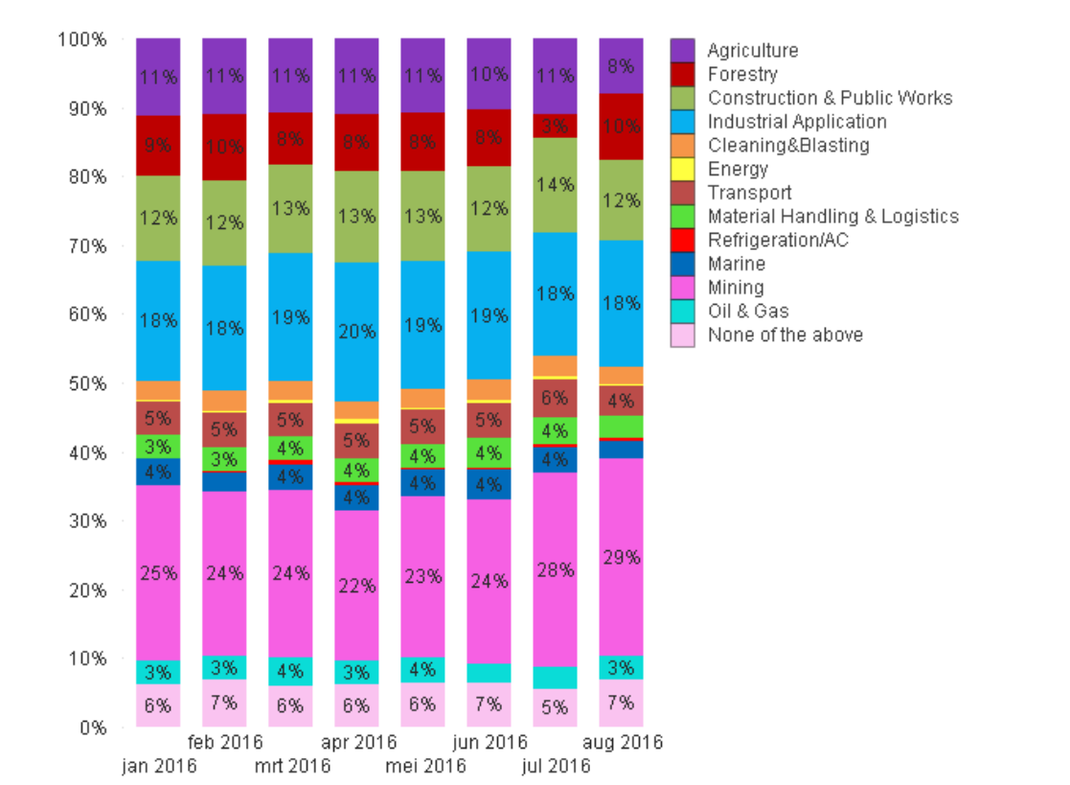
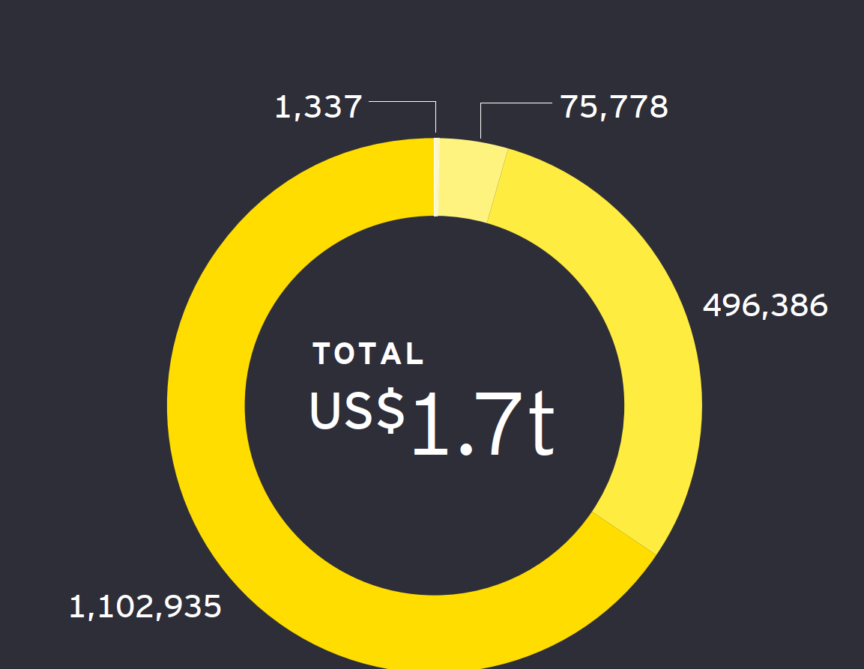
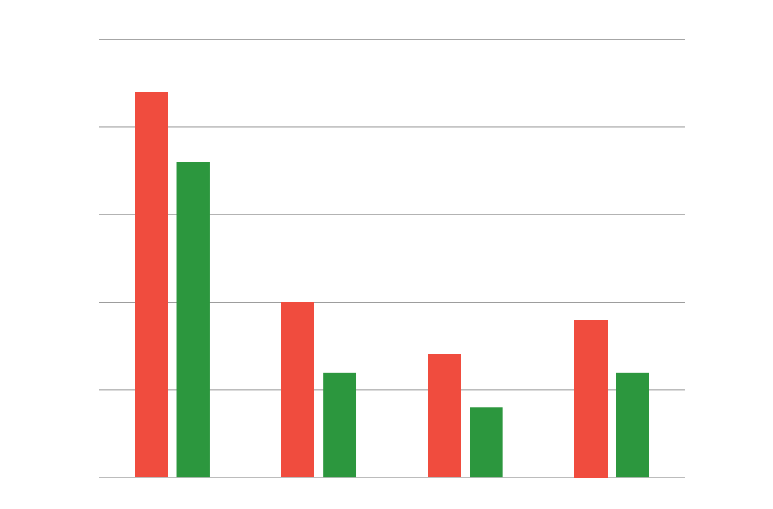
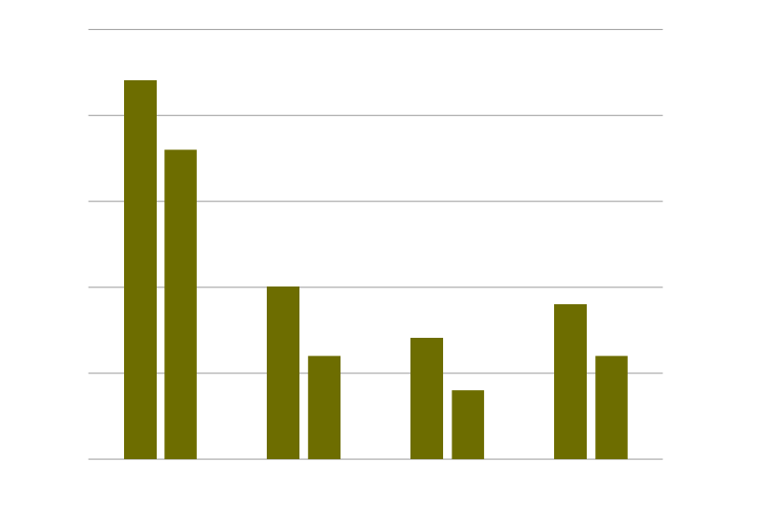
The Don’ts in Data Visualization
Color Overload
Wrong Coloring
Page 9
Notes:
Colour can vary by culture • Colours can have different meanings
Bad | Good luck | Strength | Success – RED
Good (luck) | Death | Jealousy – Blue / Green

Slide 10
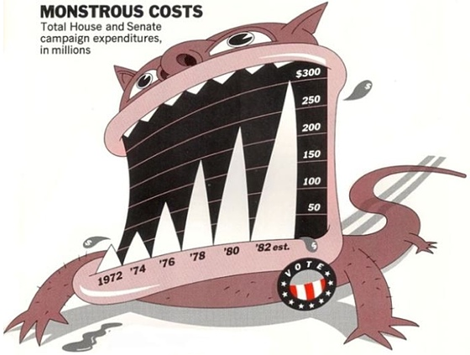
The Don’ts in Data Visualization
Chart Junk
Wrong Chart
Page 10

Slide 11
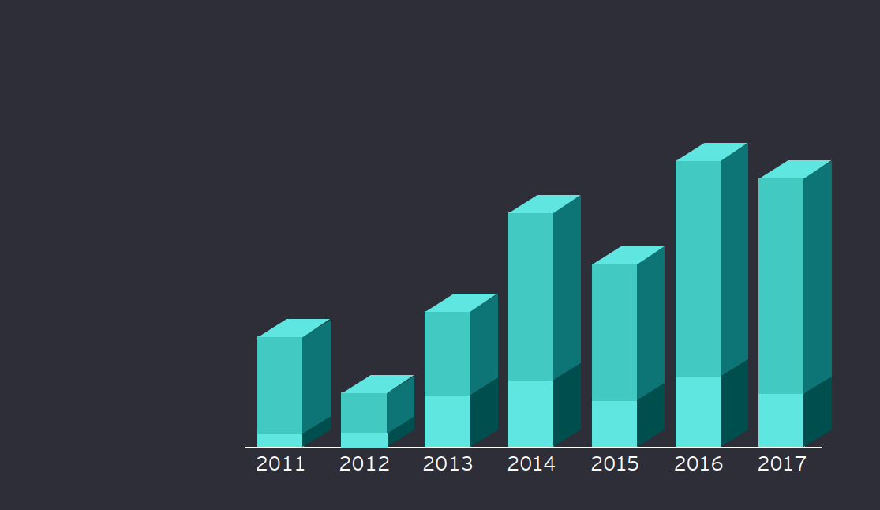
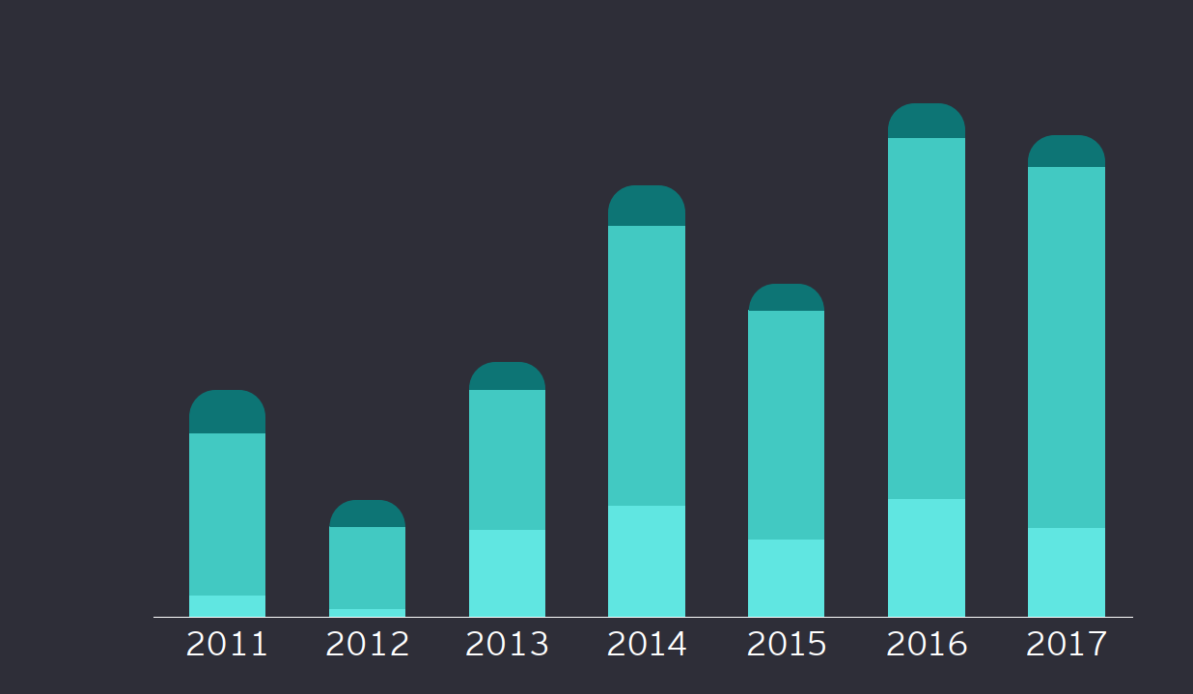
The Don’ts in Data Visualization (Others)
3 D Graphs
Rounded Corners
Page 11

Slide 12
THE RIGHT GRAPH FOR THE RIGHT DATA
Data Driven Decision Making

Slide 13
Bar Charts
Stacked Bar Chart
Corporate
Consumer
Home Office
Line Graphs
Area Charts
Shipped Early
Shipped Late
Notes:
Observations
1. The trend indicates an unexplained uptick in views and downloads in the month of June
2. The rising trend shows a steady growth in views for Delivery Toolkit
3. The growth in downloads throughout the period remained constant
Bar Charts – Bar charts are best used when you need to compare multiple variables in a single timeframe or a single variable in a time series. Bar chart can make it easier to compare the data for each variable at each moment in time.
Stacked Bar Chart – An accumulated chart displays data using rectangular columns, where their length is proportional to the value of the data. In this chart type the columns overlap, grouping the data from the same category.
Line Charts – Shows changes in one or more variables over time
Area Chart – Shows multiple values in time series. An area chart is an adaptation of a line chart where the area under the line is filled in to emphasize its significance
The difference is that the area between the baseline and the values plotted on the line is colored in. The color fill is semi-transparent so that the overlapping regions are easy to read.

Slide 14
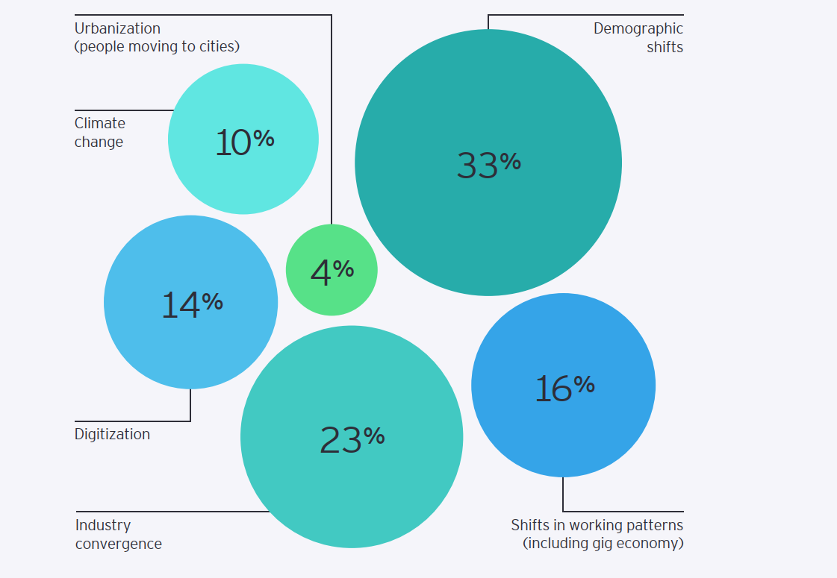
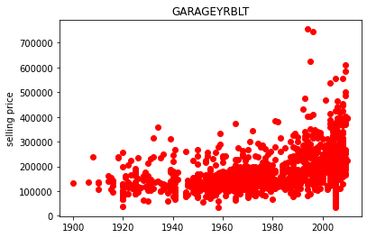
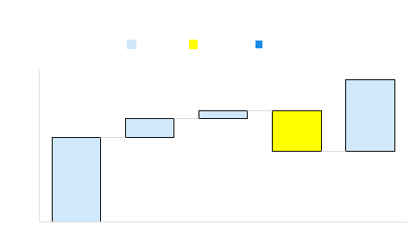
Waterfall Charts
Donut Chart
Scatter Plots
Bubble Charts
Notes:
Pie Chart – A pie chart is the best option for illustrating percentages, because it shows each element as part of a whole
Donuts – A Donut Chart is a variation of a Pie Chart but with a space in the centre.
Bubble chart– A bubble chart is an adaptation of a scatter plot, where each point is illustrated as a bubble whose area has meaning in addition to its placement on the axes.
Scatterplot – Scatter plots are used to find correlations. Each point on a scatter plot means “when x = this, then y equals this.”
When there are dots outside of the expected range, these are called outliers and should be taken into consideration when analyzing the data.
Use no more than two different colour dots and always use a legend if that’s the case.

Slide 15
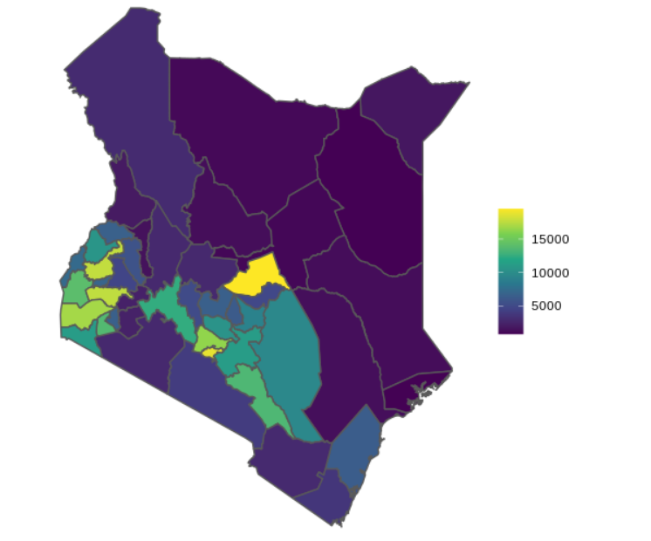
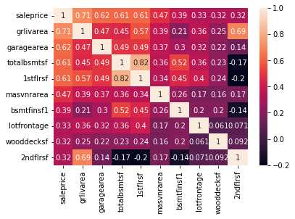
Maps
HeatMap
Distribution of population with Vision Disability
Correlation of House Price and Other Factors
Adapted from : Shel Kariuki, Building Maps with R
Notes:
Map – Much of the data dealt with in businesses has a location element, which makes it easy to illustrate on a map.
Heatmap – In heatmap data is represented by colours. The colour on the map changes depending on the value of the indicator.
Choropleth maps provide an easy way to visualize how a variable varies across a geographic area or show the level of variability within a region
The choropleth is likely the most common type of thematic map because published statistical data (from government or other sources) is generally aggregated into well-known geographic units, such as countries, states, provinces, and counties, and thus they are relatively easy to create using GIS, spreadsheets, or other software tools.

Slide 16
Tables
Portfolio Status Comparison
Asset Class | As at July 2023 |  | As at July 2022
 | Face Value (KES) | Weight (%) | Face Value (KES) | Weight (%)
Commercial Papers | 50,000 | 9% | 28,000 | 5%
Fiduciary Deposits | 68,539 | 12% | 36,050 | 7%
Fixed deposits | 20,416 | 3% | 37,759 | 7%
Money Market Funds | - | 0% | - | 0%
T bills | 2,050 | 0.4% | 537 | 0.1%
Sub total Deposits, Money Market Instruments | 142,779 | 24% | 106,103 | 21%
Debt Mutual fund | 1,217 | 0.2% | 1,769 | 0.3%
Floating rate Notes | 102,067 | 17% | 85,077 | 17%
Corporate Bonds | 144,481 | 25% | 150,302 | 29%
Supranational/Sovereign/Municipal/Soverign Agency | 193,629 | 33% | 167,720 | 33%
Sub total Debt Securities | 441,394 | 76% | 404,868 | 79%
Total Portfolio | 584,173 | 100% | 510,971 | 100%
Notes:
Tables - Tables are like mini spreadsheets and show data in rows and columns

Slide 17
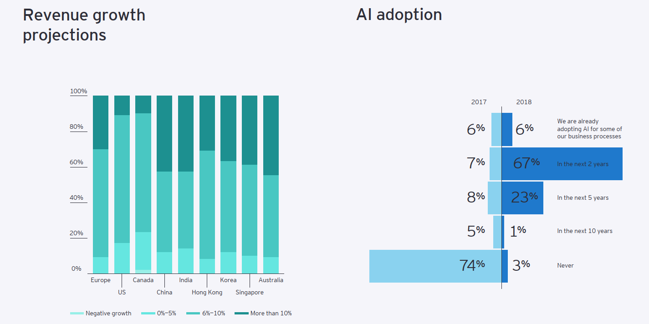
Others

Slide 18
Others
1 | 2 | 3 | 4 | 5
Not in place | Discussing | Planning | Implementing | Active
Notes:
Box Plots
Radar Polygon
Half Donut Chart
Histogram
Combo Charts
Chropleth maps
Density Plots
Candle Stick Charts
Gant Chart
Flow Chart
Tree Chart - The main idea in a tree chart is to visualize data as parts of a whole inside a category.
Check others here - https://visme.co/blog/data-visualization-types/

Slide 19
Others
Box Plots
Radar Polygon
Half Donut Chart
Histogram
Combo Charts
Chropleth maps
Density Plots
Candle Stick Charts
Gant Chart
Flow Chart
Tree Chart - The main idea in a tree chart is to visualize data as parts of a whole inside a category.
Check others here - https://visme.co/blog/data-visualization-types/
Check this data Visualization Catalogue : https://datavizcatalogue.com/
Notes:
Box Plots
Radar Polygon
Half Donut Chart
Histogram
Combo Charts
Chropleth maps
Density Plots
Candle Stick Charts
Gant Chart
Flow Chart
Tree Chart - The main idea in a tree chart is to visualize data as parts of a whole inside a category.
Check others here - https://visme.co/blog/data-visualization-types/

Slide 20
BUILDING GOOD DASHBOARDS
Data Driven Decision Making

Slide 21
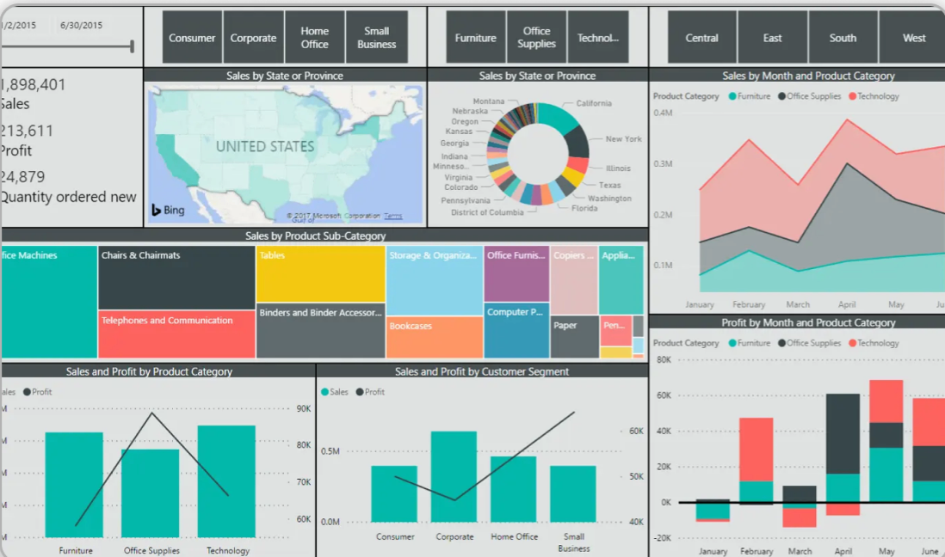
Bad Dashboard Designs
Too Much Info
Too Many Colors
Does not Answer Anything
What is Happenning
Color Bombed

Slide 22
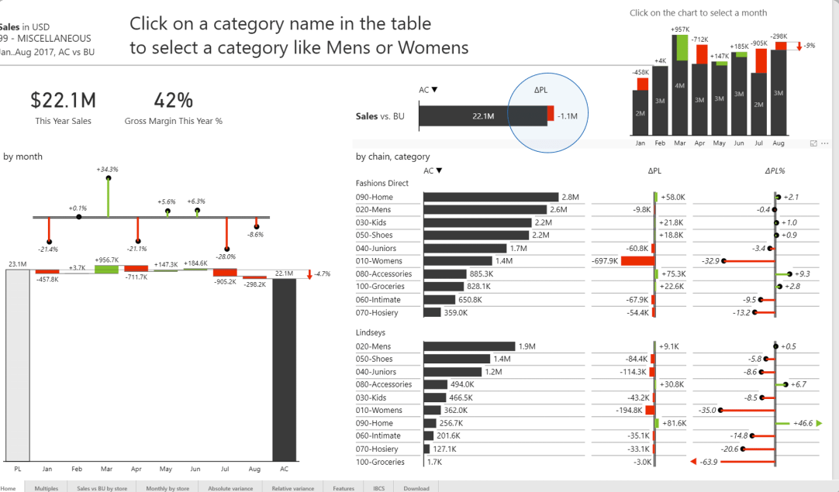
Better Design
Fewer Colors
Better Chart Selection
Focussed on Comparison

Slide 23
BRINGING IT ALL TOGETHER
Data Driven Decision Making

Slide 24
The SOLVED Storyboard provides a great framework for storytelling
The data storytelling templates are based on the logic of the SOLVED framework, which helps you organise your ideas and create powerful arguments.
The storyboard template to the right shows the logical flow from the Context, Trigger and Basic Question you are asking to a Governing Thought, which is backed up by Major Supportive Arguments, which are each in turn backed up by Minor Supportive Data or Facts.
This principle of top-down communication is often referred to as the “pyramid principle” – a concept that was explained by Barbara Minto in the book of the same name.
Communication and analysis that is based on this is regarded as the gold standard in business settings, where stakeholders need to be informed with clear, concise and logic arguments.
Governing thought (Response/Recommendation)
Context
Trigger
Basic Question to answer?
Major supportive arguments
Minor supportive data/facts
Minor 1,A
Minor 1,B
Minor 1,C
Minor supportive data/facts
Minor 1,A
Minor 1,B
Minor 1,C
Minor supportive data/facts
Minor 1,A
Minor 1,B
Minor 1,C
Page 24
Notes:
These templates won’t be appropriate for every communication that involves data, but where clear, structured communication is needed, these templates provide a quick and easy way to construct a compelling output for account teams and clients
Data Story Decks - Templated Powerpoint decks that help you plan the arguments you’re making using a clear ‘pyramid’ structure to express your findings.
Data Insights Video - Short videos (60 seconds) which present a clear argument and three pieces of supportive data in a succinct package for time-poor leaders and account teams.
When to use story decks - Data story decks are primarily designed for analysts who want to give a great top-line summary of a large amount of data or where a large number of charts are needed. The template lends itself to applications such as quarterly reports on particular markets, regions or industries.
Data Insights Video - Data insight videos are designed to give time-poor leaders a lightning fast view of key stats. The videos should primarily be used as ‘mini adverts’ for more detailed analysis documents that leaders might want to read, once their interested is piqued by the video

Slide 25




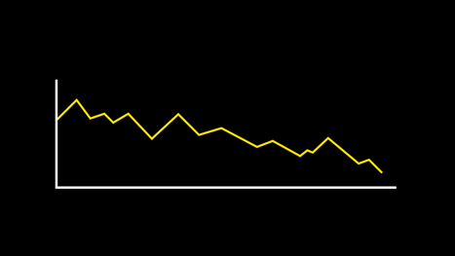
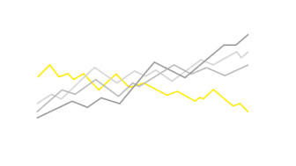
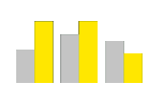
SOLVED Storyboard Example
Context
Trigger
Basic Question to answer?
Governing thought (Response/Recommendation)
Some firms in the automotive sector are divesting
Other firms might benefit from following suit
Who should the account team approach?
The account team should approach ‘Company A’ to discuss divesting
Major supportive arguments
Minor supportive data/facts
Company A has had a recent change of leadership
Company A has falling market share
Company A is spending less than competitors on R&D
Page 25

Slide 26
The structure of a data story
Each data story deck is based on the ‘pyramid’ structure set out in the SOLVED framework, which makes it easy for the reader to follow the arguments and understand the insights.
The flow of the communication Is from top to bottom. Most important things are mentioned first and supportive arguments refer to the governing thought which summarizes the key “so-what”.
Context, Trigger, Question
Governing thought
Major supportive argument
Major supportive argument
Major supportive argument
Minor supportive data/facts
Minor supportive data/facts
Minor supportive data/facts
Minor supportive data/facts
Minor supportive data/facts
Minor supportive data/facts
Minor supportive data/facts
Minor supportive data/facts
Minor supportive data/facts

Slide 27
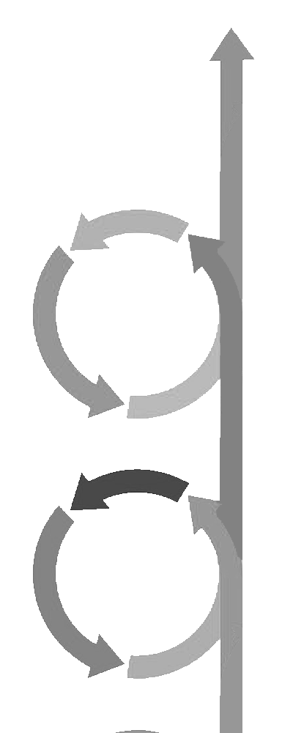
Forming hypotheses to build a logical argument
Logic pyramids are are communicated top down, but they are built from the bottom up.
The Governing Thought will be the expression of an opportunity or risk, based on a set of confirmed hypotheses
Context, Trigger, Question
Governing thought
Form hypotheses and keep returning to the data to test them, in order to create solid Major Supportive Arguments
Major supportive argument
Major supportive argument
Major supportive argument
Analyse data to find patterns or features of interest
Minor supportive data/facts
Minor supportive data/facts
Minor supportive data/facts
Minor supportive data/facts
Minor supportive data/facts
Minor supportive data/facts
Minor supportive data/facts
Minor supportive data/facts
Minor supportive data/facts

Slide 28
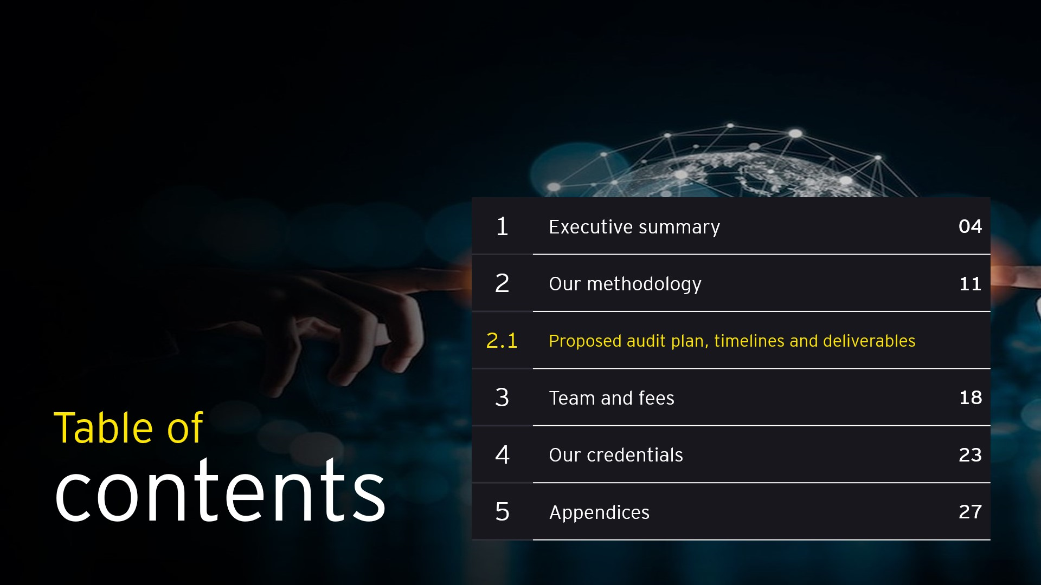
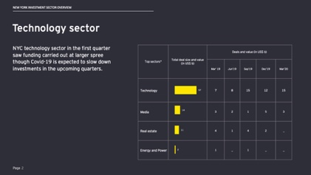
Data story decks provide structure for data insights
The data story deck template is a flexible Powerpoint template that helps you communicate data insights in a structured way.
The data story deck format won’t be appropriate for every communication, but where clear, structured communication is needed, the template provides a good way to format the insights.
Insights
Data Story deck template
Data Story Deck
Account teams

Slide 29

Context, Trigger, Question and Governing Thought
The first page of the deck sets out a clear content for the story it will tell, a trigger, which explains the reason this deck exists and then poses a question, which the deck will answer. Finally, the Governing thought is posed – this is the argument that the deck is making, which will answering the question.
Context
Trigger
Question
us
Governing thought

Slide 30
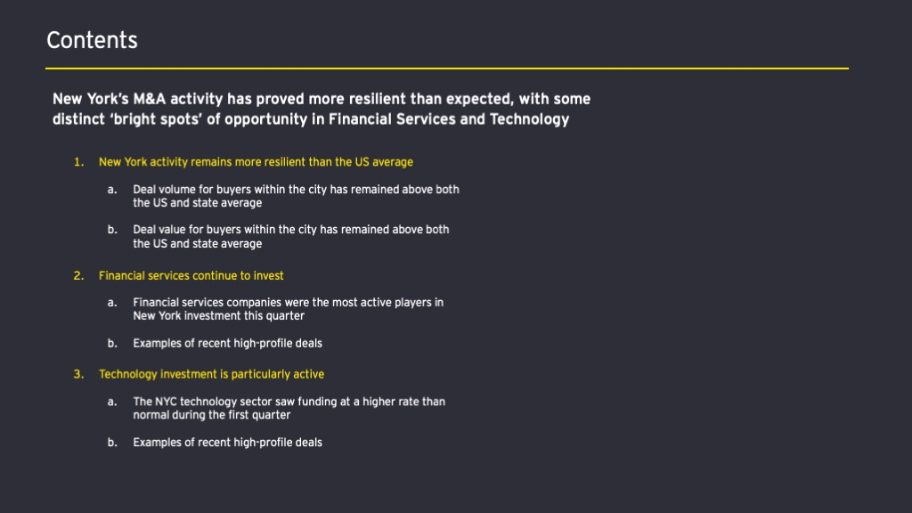
Presenting the major and minor supportive arguments
The second page of each deck repeats the governing thought, then lists the major supportive arguments and their relevant minor supportive data/facts, in the form of a contents page.
Governing thought
Major supportive arguments
Minor supportive data/facts

Slide 31
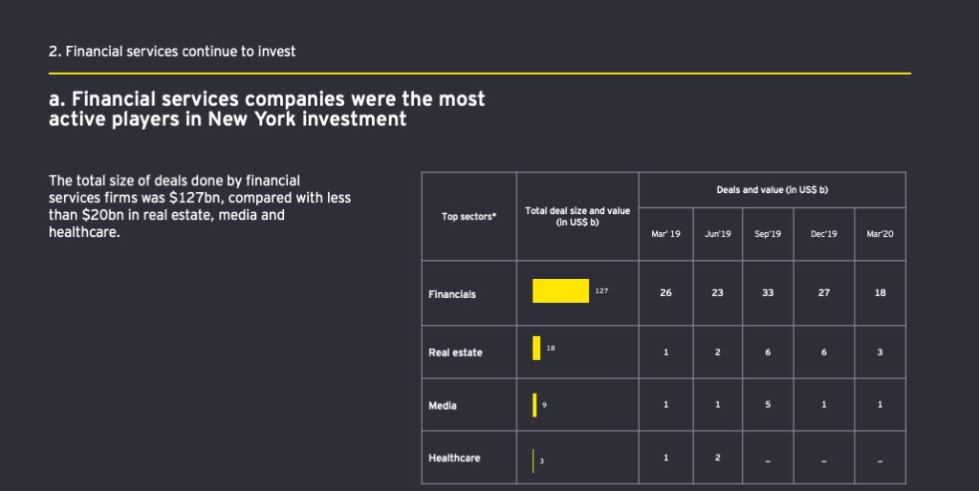
Presenting the data
Most of the pages in the deck will present data and this is done in a specific way. Each slide presents a minor supportive argument, along with data that supports that argument. On the left of the slide is always a description, explaining how the data proves the argument
Major supportive argument
Minor supportive data/facts
Brief description highlights key aspects of the data
Minor supportive data or facts

Slide 32
KEY TAKE AWAYS
Data Driven Decision Making

Slide 33
KEY TAKE AWAYS
1
2
3
4
Facts don't change minds - Stories Do.
Data tells you what’s happening. Stories tell you why it matters. Impact
Better Questions Lead to Better Answers, better communicated through stories
Facts get recorded, Stories get remembered

Slide 34
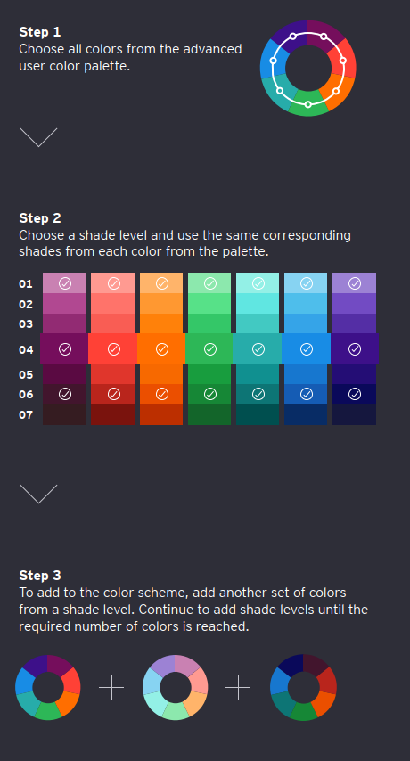
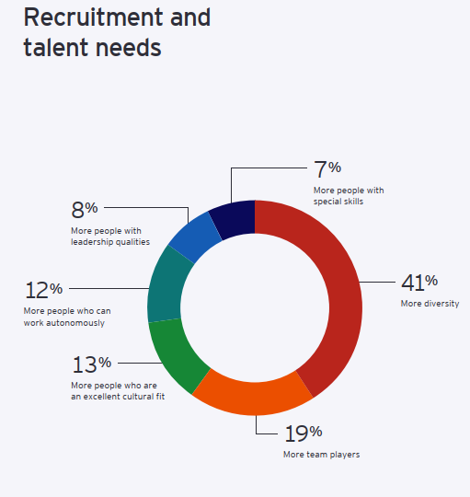
Creating Color Schemes

Slide 35
Thank You

